Slide 1
Graphs
Fonts:
MTExtra:  (comment)
Symbol: π≠∅
Wingdings: ✓

Slide 2
What’s a Graph?
A bunch of vertices connected by edges.
vertex
2
1
3
4
edge

Slide 3
Why Graph Algorithms?
They’re fun.
They’re interesting.
They have surprisingly many applications.

Slide 4
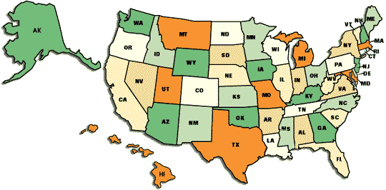
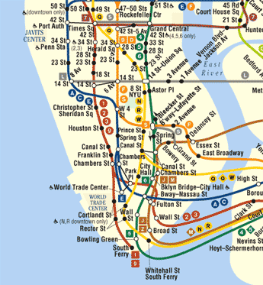
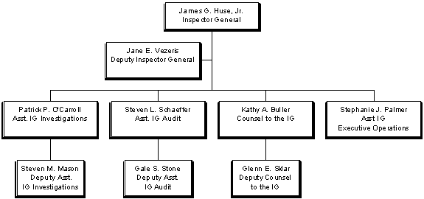
Graphs are Everywhere

Slide 5

Adjacency as a Graph
Each vertex represents a state, country, etc.
There is an edge between two vertices if the corresponding areas share a border.
WY
NE
CO
KS

Slide 6
When a Graph?
Graphs are a good representation for any collection of objects and binary relation among them:
- The relationship in space of places or objects
- The ordering in time of events or activities
- Family relationships
- Taxonomy (e.g. animal - mammal - dog)
- Precedence (x must come before y)
- Conflict (x conflicts or is incompatible with y)
- Etc.

Slide 7
Graphs
Graph consists of two sets: set V of vertices and set E of edges.
Terminology: endpoints of the edge, loop edges, parallel edges, adjacent vertices, isolated vertex, subgraph, bridge edge
Directed graph (digraph) has each edge as an ordered pair of vertices

Slide 8
Basic Concepts
A graph is an ordered pair (V, E).
V is the set of vertices. (You can think of them as integers 1, 2, …, n.)
E is the set of edges. An edge is a pair of vertices: (u, v).
Note: since E is a set, there is at most one edge between two vertices. (Hypergraphs permit multiple edges.)
Edges can be labeled with a weight:
10

Slide 9
Concepts: Directedness
In a directed graph, the edges are “one-way.” So an edge (u, v) means you can go from u to v, but not vice versa.
In an undirected graph, there is no direction on the edges: you can go either way. (Also, no self-loops.)
a self-loop

Slide 10
Concepts: Adjacency
Two vertices are adjacent if there is an edge between them.
For a directed graph, u is adjacent to v iff there is an edge (v, u).
v
v
u
w
u
w
u is adjacent to v.
v is adjacent to u and w.
w is adjacent to v.
u is adjacent to v.
v is adjacent to w.

Slide 11
Special Graphs
Simple graph is a graph without loop or parallel edges
A complete graph of n vertices K_{n} is a simple graph which has an edge between each pair of vertices
A complete bipartite graph of (n, m) vertices K_{n,m} is a simple graph consisting of vertices, v₁, v₂, …, v_{m} and w₁, w₂, …, w_{n} with the following properties:
  There is an edge from each vertex v_{i} to each vertex w_{j}
  There is no edge from any vertex v_{i} to any vertex v_{j}
  There is no edge from any vertex w_{i} to any vertex w_{j}

Slide 12
Concepts: Degree
Undirected graph: The degree of a vertex is the number of edges touching it.
For a directed graph, the in-degree is the number of edges entering the vertex, and the out-degree is the number leaving it. The degree is the in-degree + the out-degree.
degree 4
in-degree 2, out-degree 1

Slide 13
Paths and Circuits
A walk in a graph is an alternating sequence of adjacent vertices and edges
A path is a walk that does not contain a repeated edge
Simple path is a path that does not contain a repeated vertex
A closed walk is a walk that starts and ends at the same vertex
A circuit is a closed walk that does not contain a repeated edge
A simple circuit is a circuit which does not have a repeated vertex except for the first and last

Slide 14
Concepts: Path
A path is a sequence of adjacent vertices. The length of a path is the number of edges it contains, i.e. one less than the number of vertices.
We write u ⇒ v if there is path from u to v. (The correct symbol, a wiggly arrow, is not available in standard fonts.) We say v is reachable from u.
2
Is there a path from 1 to 4?
What is its length?
What about from 4 to 1?
How many paths are there from 2 to 3? From 2 to 2? From 1 to 1?
1
3
4

Slide 15
Concepts: Cycle
A cycle is a path of length at least 1 from a vertex to itself.
A graph with no cycles is acyclic.
A path with no cycles is a simple path.
The path <2, 3, 4, 2> is a cycle.
2
1
3
4

Slide 16
Concepts: Connectedness
An undirected graph is connected iff there is a path between any two vertices.
The adjacency graph of U.S. states has three connected components. Name them.
(We say a directed graph is strongly connected iff there is a path between any two vertices.)
An unconnected graph with three connected components.

Slide 17
Connectedness
Two vertices of a graph are connected when there is a walk between two of them.
The graph is called connected when any pair of its vertices is connected
If graph is connected, then any two vertices can be connected by a simple path
If two vertices are part of a circuit and one edge is removed from the circuit then there still exists a path between these two vertices
Graph H is called a connected component of graph G when H is a subgraph of G, H is connected and H is not a subgraph of any bigger connected graph
Any graph is a union of connected components

Slide 18
Euler Circuit
Euler circuit is a circuit that contains every vertex and every edge of a graph. Every edge is traversed exactly once.
If a graph has Euler circuit then every vertex has even degree. If some vertex of a graph has odd degree then the graph does not have an Euler circuit
If every vertex of a graph has even degree and the graph is connected then the graph has an Euler circuit
A Euler path is a path between two vertices that contains all vertices and traverces all edge exactly ones
There is an Euler path between two vertices v and w iff vertices v and w have odd degrees and all other vertices have even degrees

Slide 19
Hamiltonian Circuit
Hamiltonian circuit is a simple circuit that contains all vertices of the graph (and each exactly once)
Traveling salesperson problem

Slide 20
Concepts: Trees
A free tree is a connected,
acyclic, undirected graph.
To get a rooted tree (the kind we’ve used up until now), designate some vertex as the root.
If the graph is disconnected, it’s a forest.
Facts about free trees:
|E| = |V| -1
Any two vertices are connected by exactly one path.
Removing an edge disconnects the graph.
Adding an edge results in a cycle.

Slide 21
Rooted Trees
Rooted tree is a tree in which one vertex is distinguished and called a root
Level of a vertex is the number of edges between the vertex and the root
The height of a rooted tree is the maximum level of any vertex
Children, siblings and parent vertices in a rooted tree
Ancestor, descendant relationship between vertices

Slide 22
Binary Trees
Binary tree is a rooted tree where each internal vertex has at most two children: left and right. Left and right subtrees
Full binary tree
Representation of algebraic expressions
If T is a full binary tree with k internal vertices then T has a total of 2k + 1 vertices and k + 1 of them are leaves
Any binary tree with t leaves and height h satisfies the following inequality: t ≤ 2^{h}

Slide 23
Spanning Trees
A subgraph T of a graph G is called a spanning tree when T is a tree and contains all vertices of G
Every connected graph has a spanning tree
Any two spanning trees have the same number of edges
A weighted graph is a graph in which each edge has an associated real number weight
A minimal spanning tree (MST) is a spanning tree with the least total weight of its edges

Slide 24
Graph Size
We describe the time and space complexity of graph algorithms in terms of the number of vertices, |V|, and the number of edges, |E|.
|E| can range from 0 (a totally disconnected graph) to |V|² (a directed graph with every possible edge, including self-loops).
Because the vertical bars get in the way, we drop them most of the time.
E.g. we write Θ(V + E) instead of Θ(|V| + |E|).

Slide 25
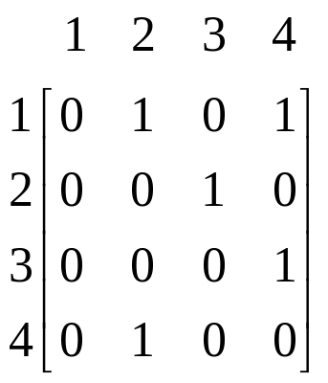
Representing Graphs
2
1
3
4
Adjacency matrix: if there is an edge from vertex i to j, a_{ij} = 1; else, a_{ij} = 0.
Space: Θ(V²)
Adjacency list: Adj[v] lists the vertices adjacent to v.
Space: Θ(V+E)
Adj:
1
2
4
2
3
3
4
4
2
Represent an undirected graph by a directed one:

Slide 26
Depth-First Search
A way to “explore” a graph. Useful in several algorithms.
Remember preorder traversal of a binary tree?
Binary-Preorder(x):
1 number x
2 Binary-Preorder(left[x])
3 Binary-Preorder(right[x])
Can easily be generalized to trees whose nodes have any number of children.
This is the basis of depth-first search. We “go deep.”
1
2
5
3
4
6
7

Slide 27
DFS on Graphs
The wrong way:
Bad-DFS(u)
1 number u
2 for each v in Adj[u] do
3 Bad-DFS(v)
What’s the problem?
1
2
5
3
4
6
7

Slide 28
Fixing Bad-DFS
We’ve got to indicate when a node has been visited.
Following CLRS, we’ll use a color:
WHITE never seen
GRAY discovered but not finished
(still exploring its descendants)
BLACK finished

Slide 29
A Better DFS
 initially, all vertices are WHITE
Better-DFS(u)
color[u] ← GRAY
number u with a “discovery time”
for each v in Adj[u] do
if color[v] = WHITE then  avoid looping!
Better-DFS(v)
color[u] ← BLACK
number u with a “finishing time”

Slide 30
Depth-First Spanning Tree
As we’ll see, DFS creates a tree as it explores the graph. Let’s keep track of the tree as follows (actually it creates a forest not a tree):
When v is explored directly from u, we will make u the parent of v, by setting the predecessor, aka, parent (π) field of v to u:
u
u
v
v
π[v] ← u

Slide 31
Two More Ideas
1. We will number each vertex with discovery and finishing times—these will be useful later.
The “time” is just a unique, increasing number.
The book calls these fields d[u] and f[u].
2. The recursive routine we’ve written will only explore a connected component. We will wrap it in another routine to make sure we explore the entire graph.

Slide 32
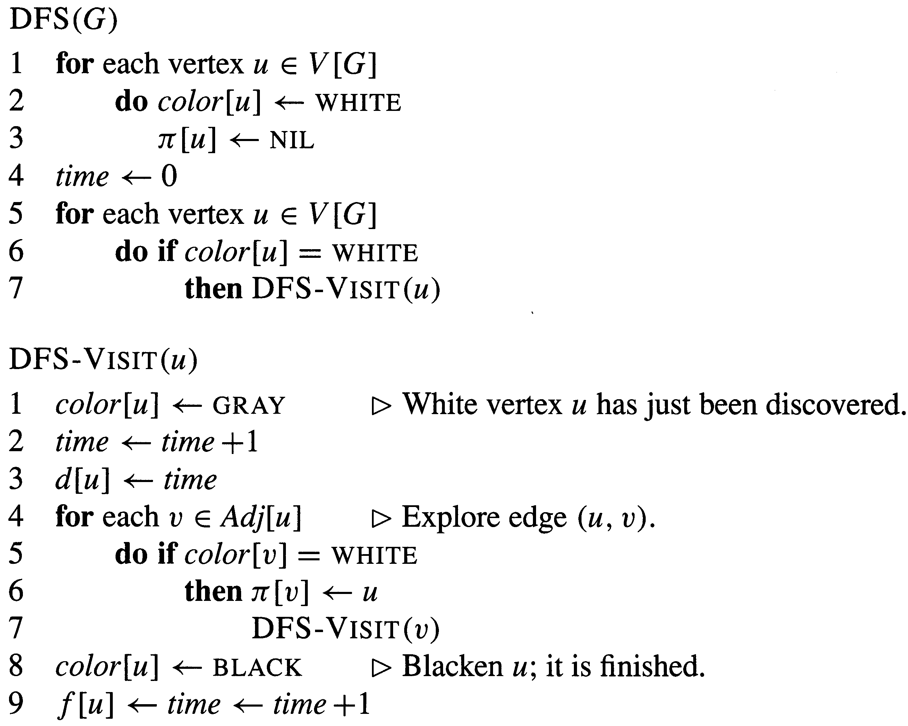

Slide 33
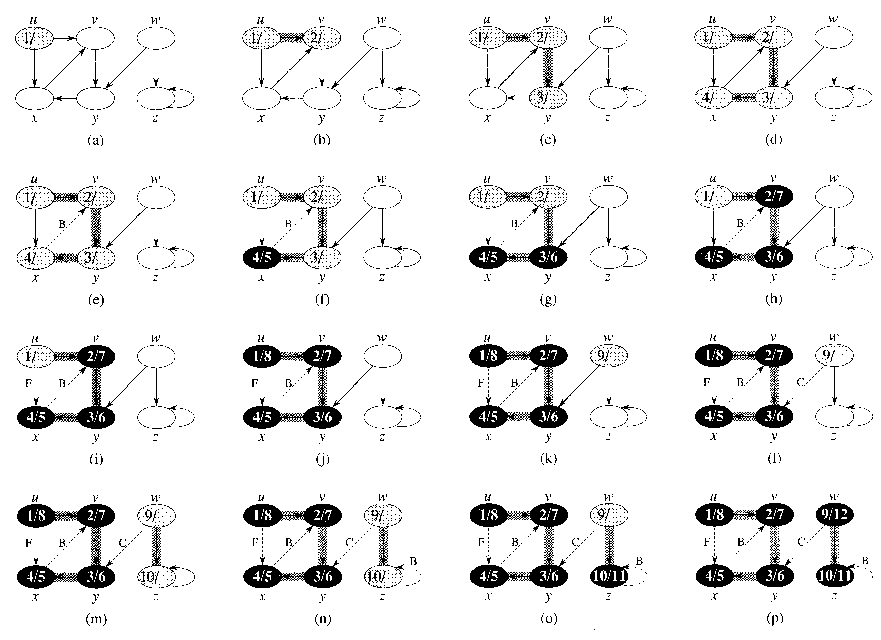

Slide 34
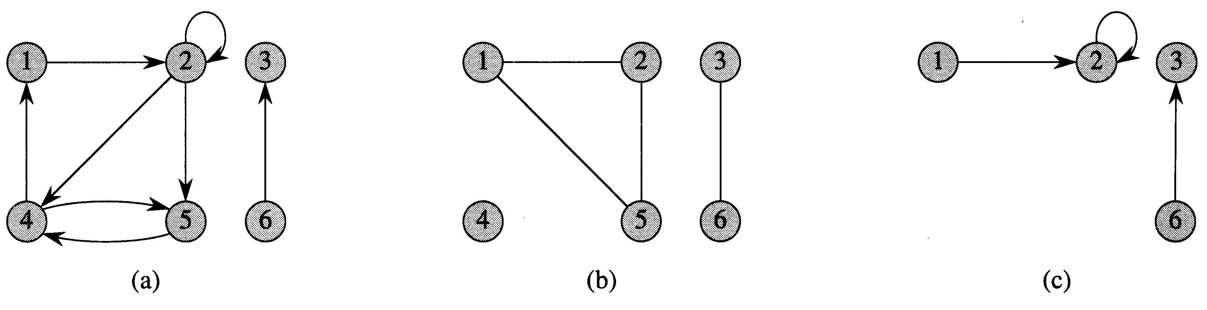
graphs from p. 1081

Slide 35
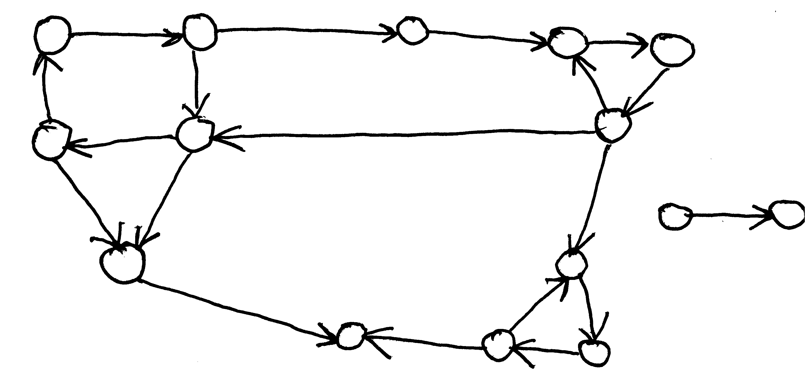
show strongly connected comps
see next slide

Slide 36
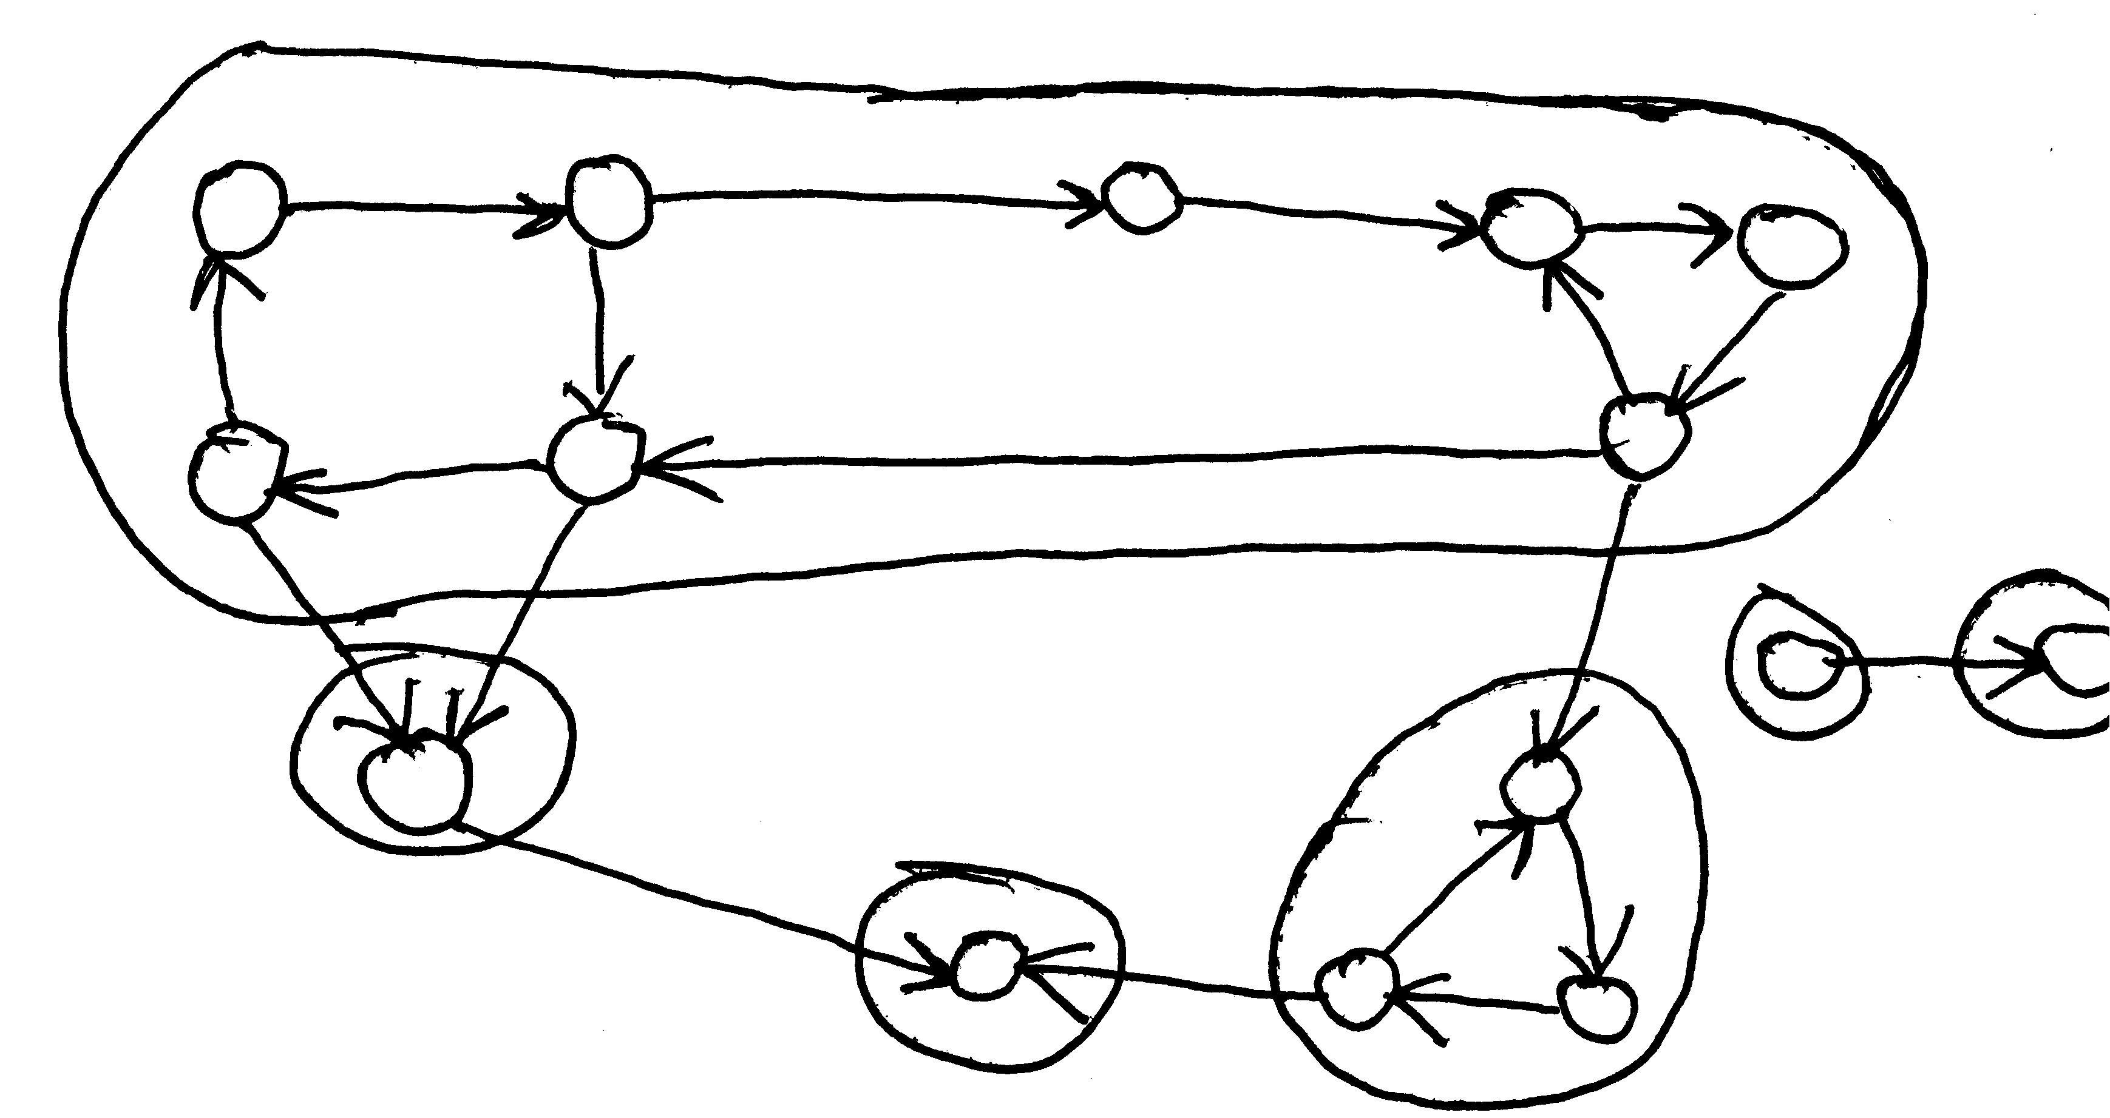
from prev slide

Slide 37
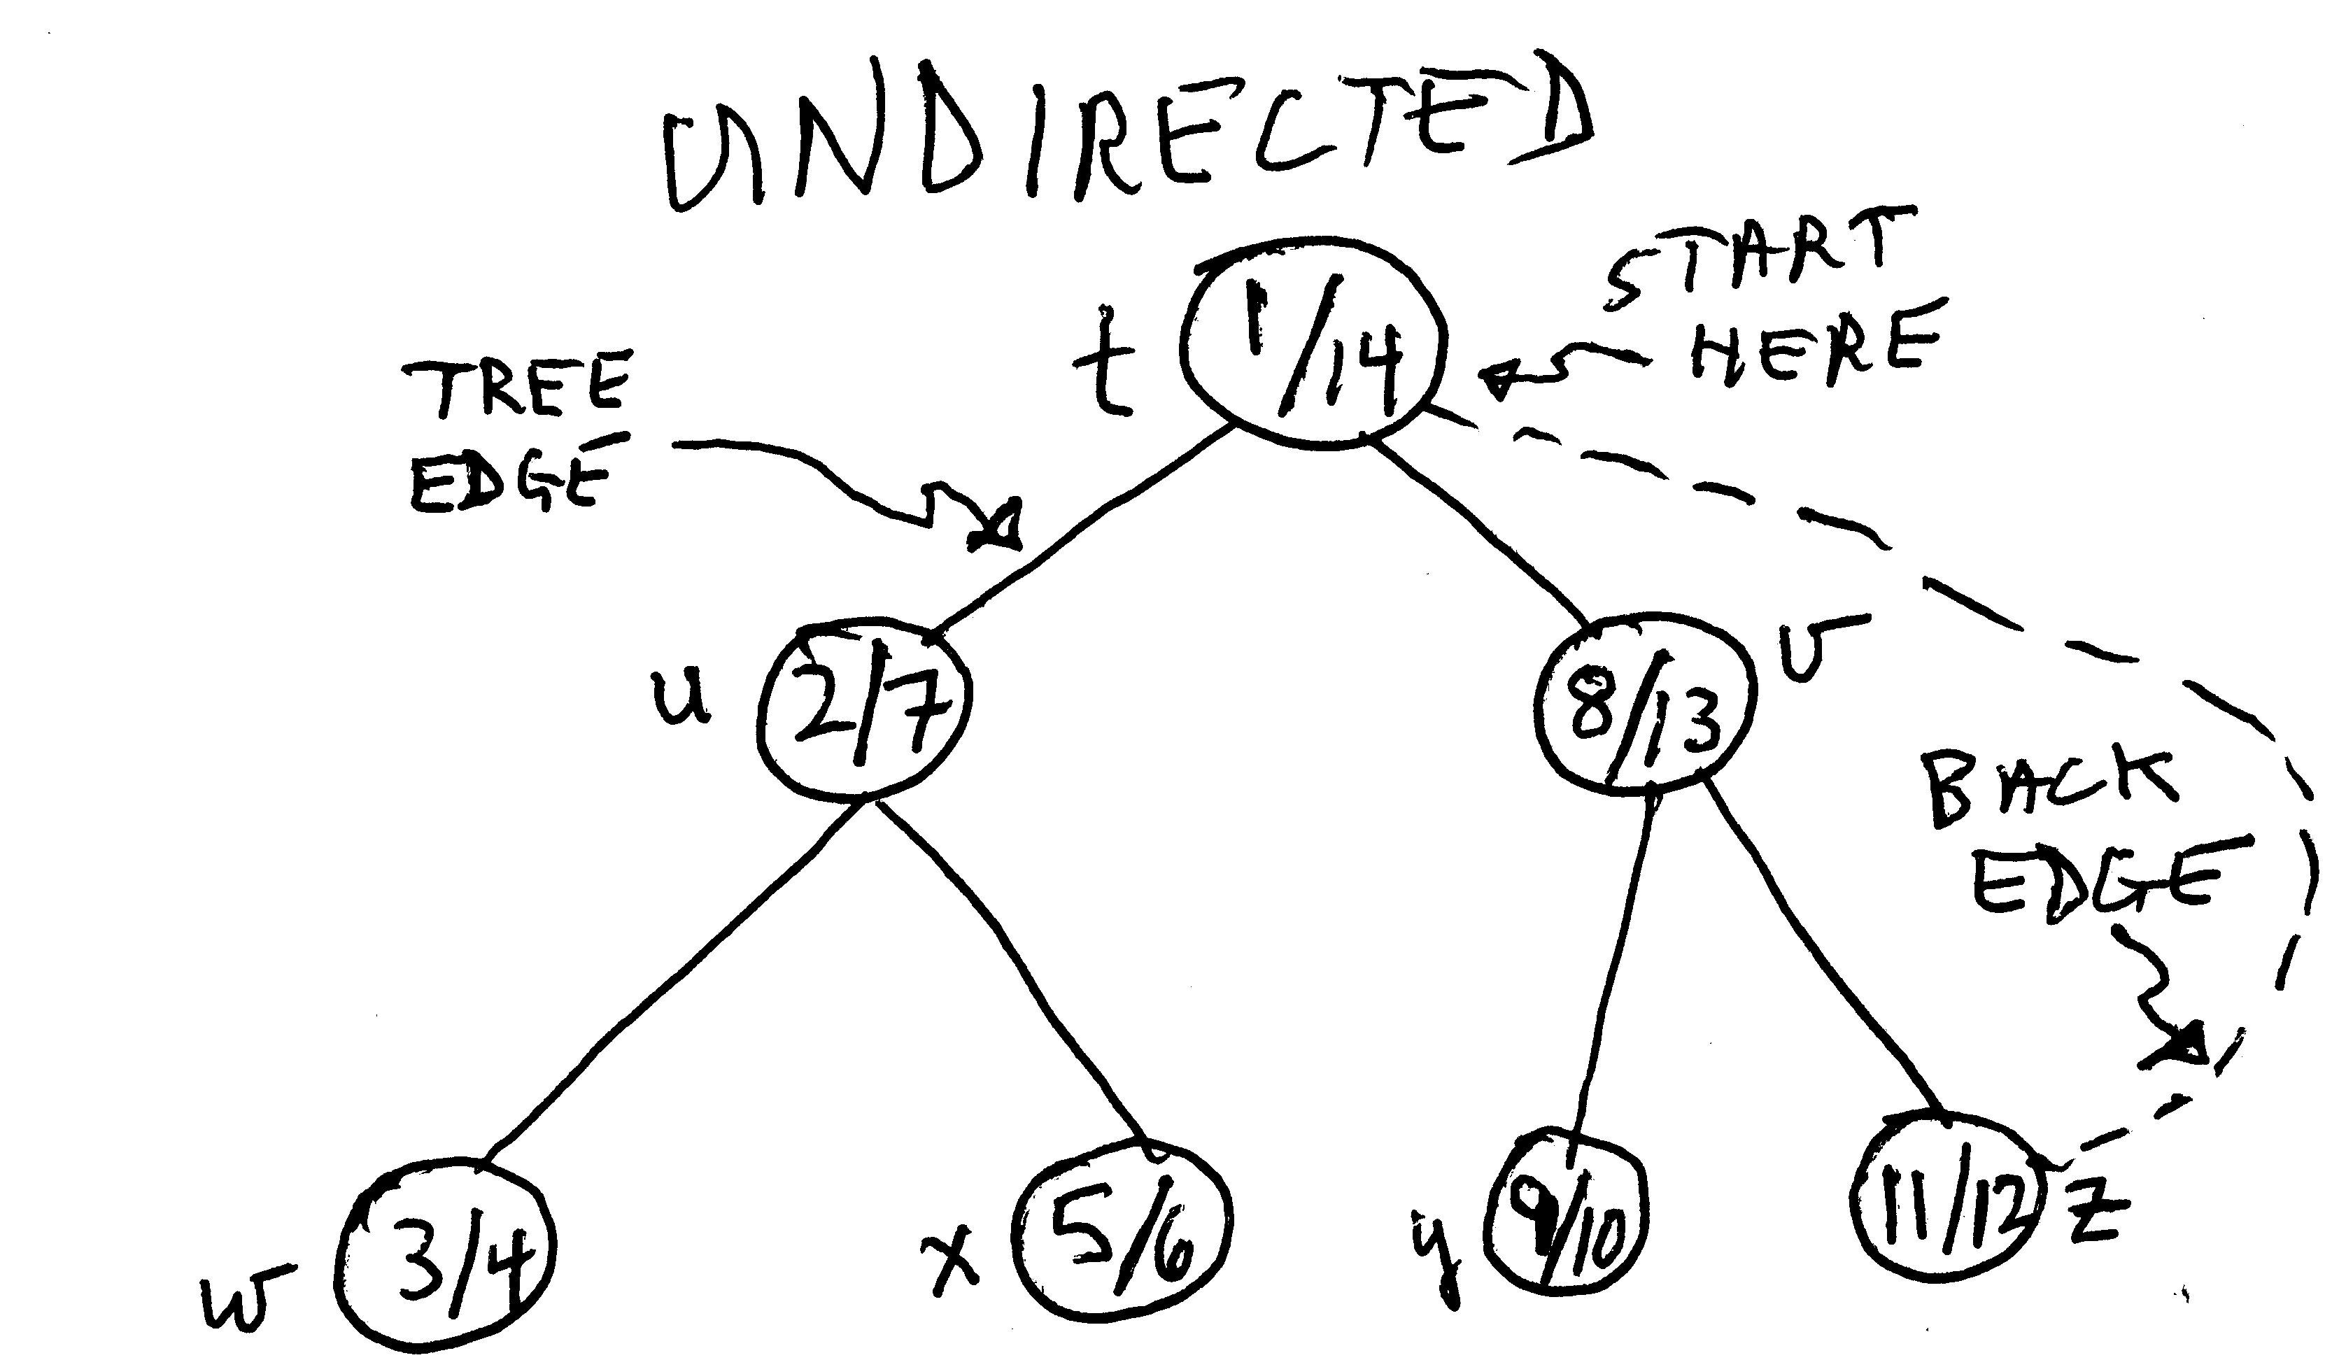
DFS examples
On an undirected graph, any edge that is not a “tree” edge is a “back” edge (from descendant to ancestor).

Slide 38
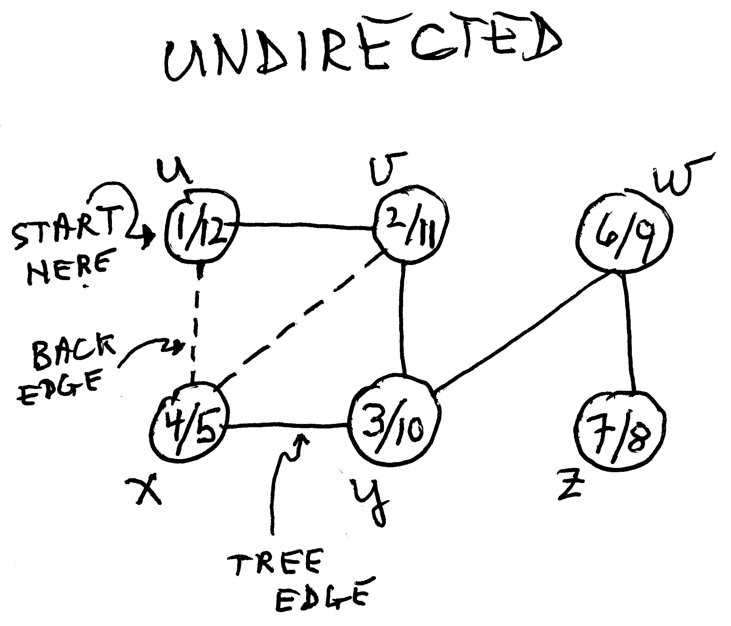
DFS Examples

Slide 39
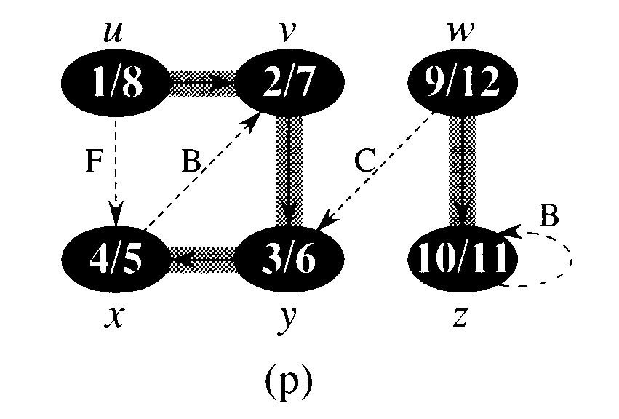
DFS Example: digraph
Here, we get a forest (two trees).
B = back edge (descendant to ancestor, or self-loop)
F = forward edge (ancestor to descendant)
C = cross edge (between branches of a tree, or between trees)

Slide 40
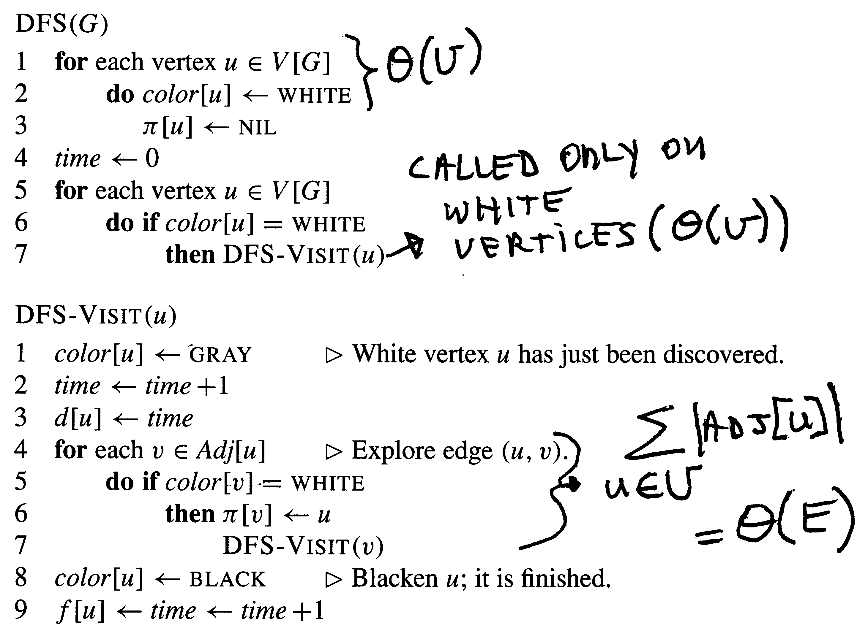
DFS running time is Θ(V+E)
we visit each vertex once; we traverse each edge once

Slide 41
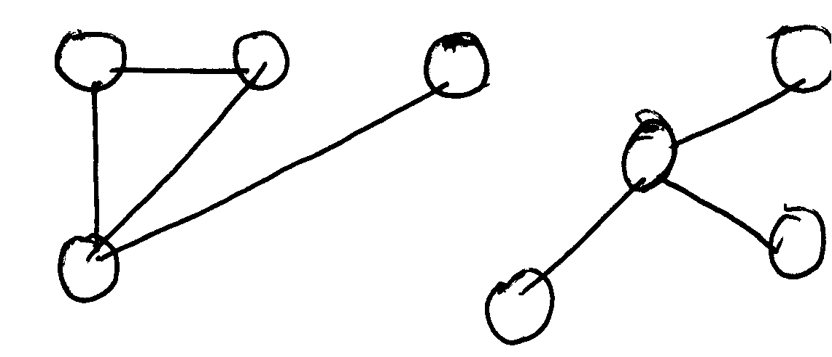
applications of DFS
Connected components of an undirected graph. Each call to DFS_VISIT (from DFS) explores an entire connected component (see ex. 22.3-11).
So modify DFS to count the number of times it calls DFS_VISIT:
5 for each vertex u Є V[G]
6 do if color[u] = WHITE
6.5 then cc_counter ← cc_counter + 1
7 DFS_VISIT(u)
Note: it would be easy to label each vertex with its cc number, if we wanted to (i.e. add a field to each vertex that would tell us which conn comp it belongs to).

Slide 42
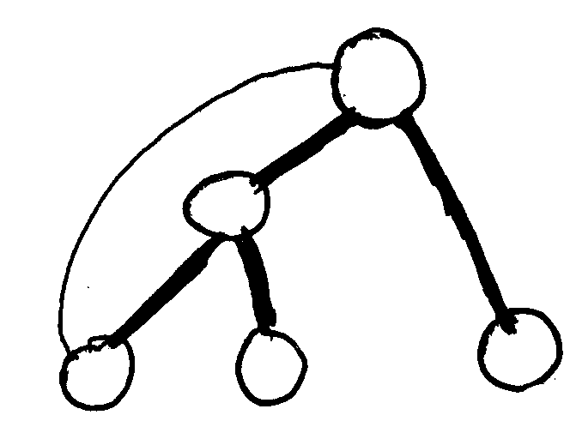
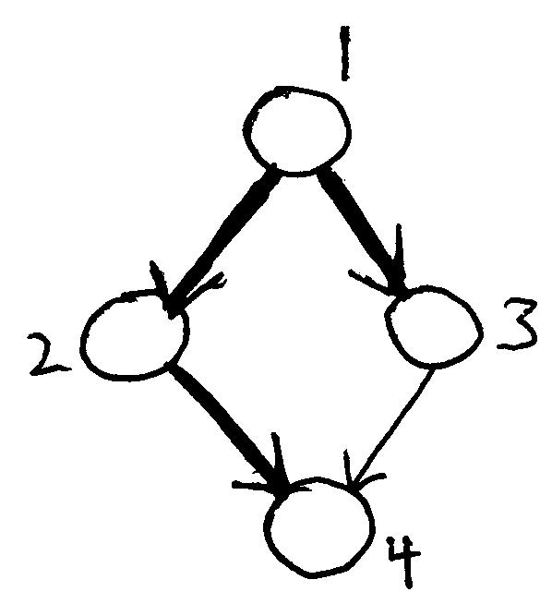
Applications of DFS
Cycle detection: Does a given graph G contain a cycle?
Idea #1: If DFS ever returns to a vertex it has visited, there is a cycle; otherwise, there isn’t.
OK for undirected graphs, but what about:
No cycles, but a DFS from 1 will reach 4 twice. Hint: what kind of edge is (3, 4)?

Slide 43
Cycle detection theorem
Theorem: A graph G (directed or not) contains a cycle if and only if a DFS of G yields a back edge.
→: Assume G contains a cycle. Let v be the first vertex reached on the cycle by a DFS of G. All the vertices reachable from v will be explored from v, including the vertex u that is just “before” v in the cycle. Since v is an ancestor of u, the edge (u,v) will be a back edge.
←: Say the DFS results in a back edge from u to v. Clearly, u→v (that should be a wiggly arrow, which means, “there is a path from u to v”, or “v is reachable from u”). And since v is an ancestor of u (by def of back edge), v→u (again should be wiggly). So v and u must be part of a cycle. QED.

Slide 44
Back Edge Detection
How can we detect back edges with DFS? For undirected graphs, easy: see if we’ve visited the vertex before, i.e. color ≠ WHITE.
For directed graphs: Recall that we color a vertex GRAY while its adjacent vertices are being explored. If we re-visit the vertex while it is still GRAY, we have a back edge.
We blacken a vertex when its adjacency list has been examined completely. So any edges to a BLACK vertex cannot be back edges.

Slide 45
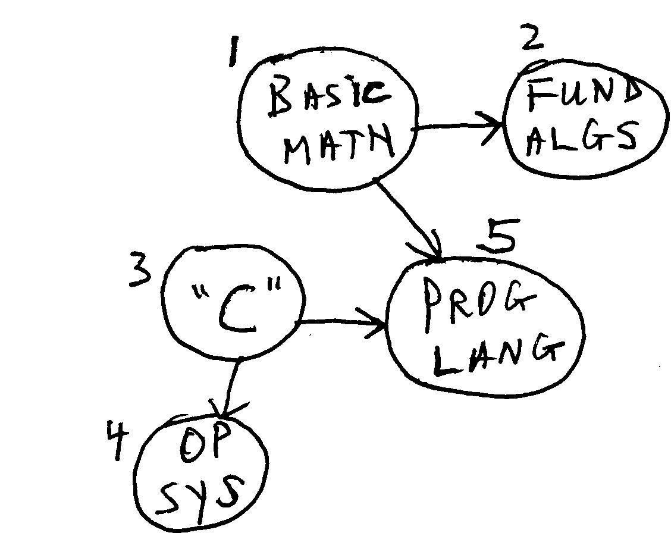
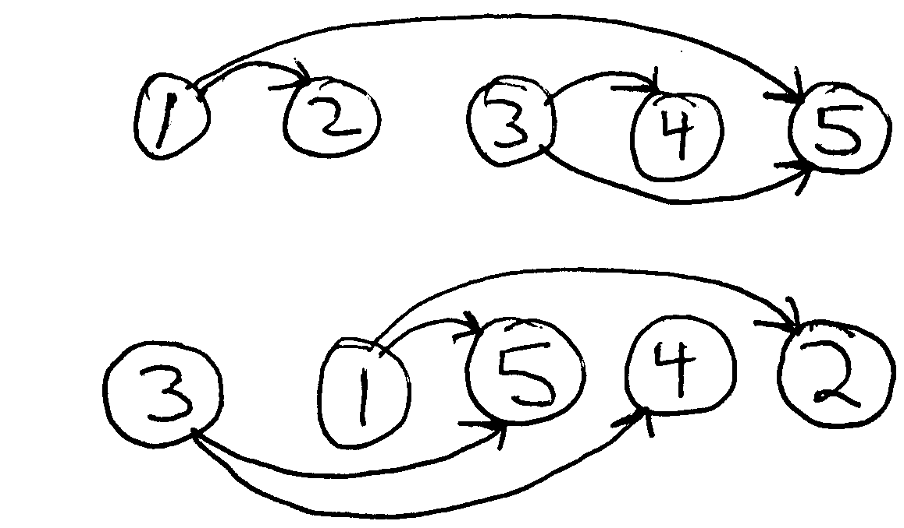
TOPOLOGICAL SORT
“Sort” the vertices so all edges go left to right.

Slide 46
TOPOLOGICAL SORT
For topological sort to work, the graph G must be a DAG (directed acyclic graph). G’s undirected version (i.e. the version of G with the “directions” removed from the edges) need not be connected.
Theorem: Listing a dag’s vertices in reverse order of finishing time (i.e. from highest to lowest) yields a topological sort.
Implementation: modify DFS to stick each vertex onto the front of a linked list as the vertex is finished.
see examples next slide....

Slide 47
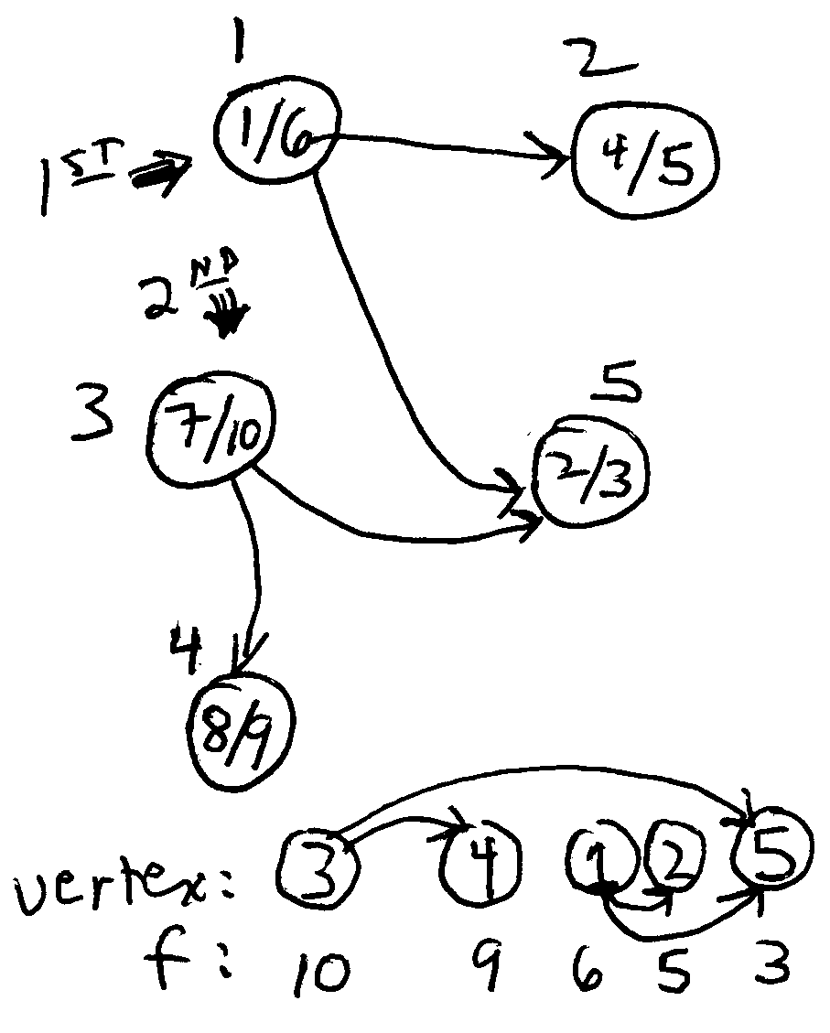
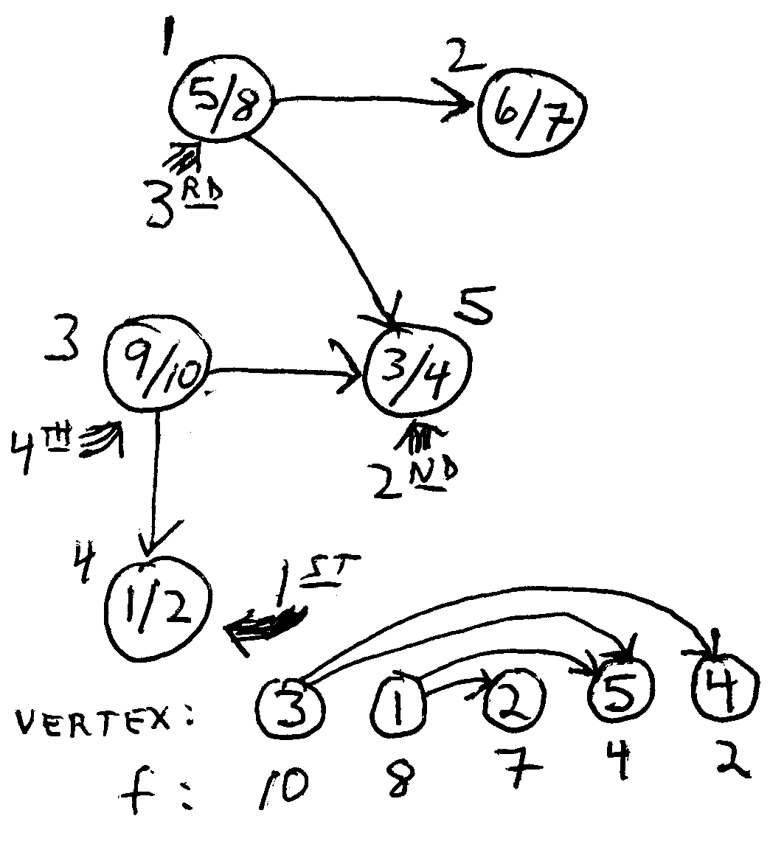
Topological Sort Examples

Slide 48
More on Topological Sort
Theorem (again): Listing a dag’s vertices in order of highest to lowest finishing time results in a topological sort. Putting it another way: If there is an edge (u,v), then f[u] > f[v].
Proof : Assume there is an edge (u,v).
Case 1: DFS visits u first. Then v will be visited and finished before u is finished, so f[u] > f[v].
Case 2: DFS visits v first. There cannot be a path from v to u (why not?), so v will be finished before u is even discovered. So again, f[u] > f[v].
QED.

Slide 49
Introduction
Start with a connected, undirected graph, and add real-valued weights to each edge.
The weights could indicate time, distance, cost, capacity, etc.
6
5
1
5
5
3
2
6
4
6

Slide 50
Definitions
A spanning tree of a graph G is a tree that contains every vertex of G.
The weight of a tree is the sum of its edges’ weights.
A minimal spanning tree is a spanning tree with lowest weight. (The left tree is not minimal. The right one is, as we will see.)
6
5
6
5
1
1
5
5
5
5
3
2
3
2
6
4
6
4
6
6
weight = 21
weight = 15

Slide 51
An Application of MSTs
Wire up a network among several computers so that every computer can reach (directly or indirectly) every other. Use the minimum amount of cable.
Vertices = computers
Weights = distance between computers
Another example: think about inter-connecting a set of n pins, using n–1 wires, using the minimal amount of wire.

Slide 52
The MST Property: Intro
Divide the vertices of a
graph into two sets
(this is a cut of the graph).
Consider an edge of lowest weight on the cut (e.g. 4, above).
This edge is in some MST of the graph.
6
5
1
5
5
3
2
6
4
6

Slide 53
Proving the MST Property: 1
Recall: A tree is an acyclic, connected, undirected graph
Lemma 1: Adding an edge to a
tree results in a cycle.
Proof: Say the edge is from u to v. There was already a path from v to u (since the tree is connected); now there is an edge from u to v, forming a cycle.
u
v

Slide 54
Proving the MST Property: 2
Lemma 2: Adding an edge to a tree, then removing a different edge along the resulting cycle, still results in a tree.
Proof: Omitted.

Slide 55
The MST Property
Theorem: Given a cut of a graph, a lowest-weight edge crossing the cut will be in some MST for the graph.
Proof: By contradiction.
Assume an MST on the
graph containing no
lowest-weight edge
crossing the cut. Then some other, higher-weight edge on the cut is in the MST (since it is a spanning tree). (continued)
higher-weight edge
lowest-weight edge

Slide 56
MST Property Proof, Cont.
cut
higher-weight edge
lowest-weight edge
If we now add the lowest-weight edge to the supposed MST, we have a cycle. Removing the higher-weight one still results in a spanning tree, and it has a lower total weight than the alleged MST. Thus the assumption is false: some lowest-weight edge is in the MST. 

Slide 57
MST Algorithms
Both of the MST algorithms we will study exploit the MST property.
  Kruskal’s: repeatedly add the lowest-weight legal edge to a growing MST.
  Prim’s (really Prim-Jarvik): keep track of a cut, and add the lowest-weight edge across the cut to the growing MST.

Slide 58
Kruskal’s Algorithm
Choose the lowest-weight edge in the graph. This is certainly the lowest weight edge for some cut, so it must be in an MST.
Continue taking the lowest-weight edge and adding it to the MST, unless it would result in a cycle.

Slide 59
Kruskal’s Example
✓
1
a
c
6
a
5
1
✓
2
b
d
d
f
5
c
5
3
3
2
✓
b
e
6
4
e
6
f
4
✓
c
f
x
5
c
d
5
✓
b
c

Slide 60
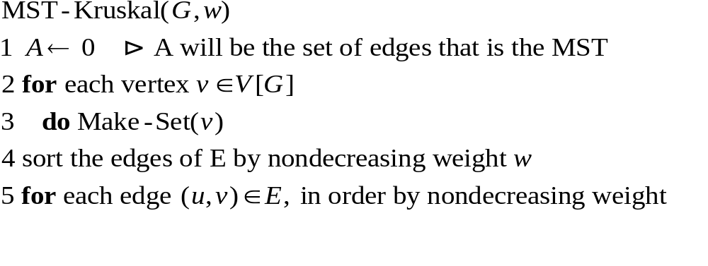
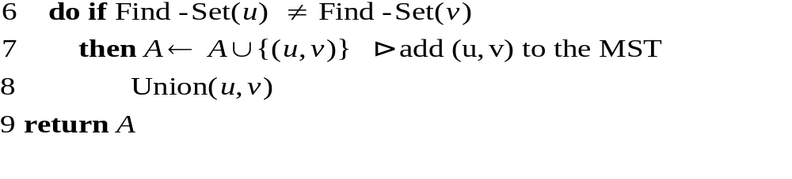
KRUSKAL CODE

Slide 61
Aside: The Union-Find Problem
(This relates to the running time of Kruskal...)
Given several items, in disjoint sets, support three operations:
– Make-Set(x): create a set containing x
  Find-Set(x): return the set to which x belongs
  Union(x, y): take the union of sets of x and y
The “disjoint-set forests” implementation of union-find, with certain heuristics, yields outstanding performance. The running time of these operations is (for all practical purposes) linear in m ( the total number of operations). See section 21.3 for more details...

Slide 62
Fast Union-Find
Choose an item as the representative of its set.
  Find-Set(x): return x’s representative
  Union(x, y): make x’s representative point to y
With path compression:
  Union(x, y): make x and everything on the path to its representative point to y
Time for n Union-finds: Θ(nlg*n).
lg*n is the iterated logarithm function: the number of times you must take lgn in order to get ≤ 1.
For all practical purposes, lg*n < 4.

Slide 63
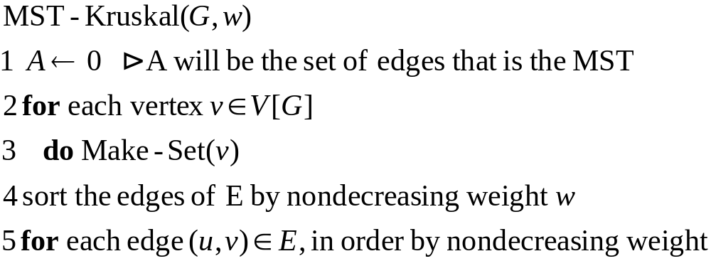
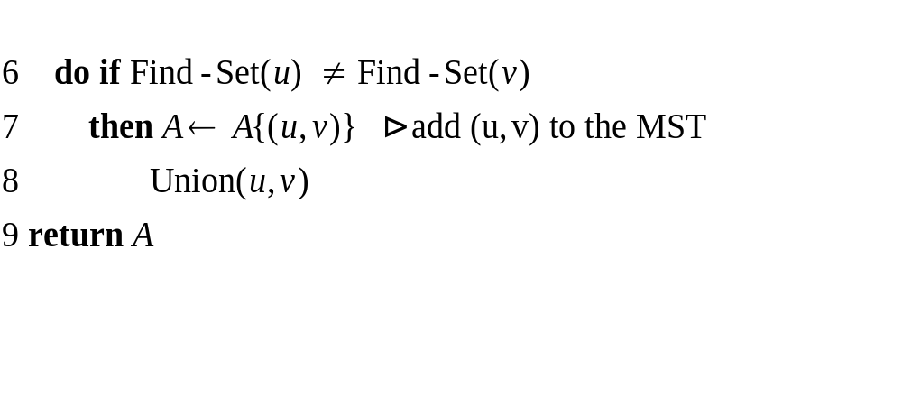
Running Time of Kruskal’s
Θ(ElgE)
Done E times.
Θ(Elg*E)
Total: Θ(ElgE) time.

Slide 64
Prim’s Algorithm
Begin with any vertex. Choose the lowest weight edge connected to that vertex.
Add the vertex on the other side of that edge to the “active set.”
Again, choose the
lowest-weight edge of
any vertex in the active
set that connects to a
vertex outside the set, and repeat.
start here
6
5
1
5
5
3
2
6
4
6

Slide 65
Prim’s Example
a
a
a
6
5
6
5
6
5
1
1
1
b
d
b
d
b
d
5
c
5
5
c
5
5
c
5
3
2
3
2
3
2
6
4
6
4
6
4
e
f
e
6
f
e
f
6
6
a
a
6
5
6
5
1
1
b
d
b
d
5
c
5
5
c
5
3
2
3
2
6
4
6
4
e
6
f
e
6
f

Slide 66
Why Prim’s Works
It comes right out of the MST property.
There are always two sets, the active set and everything else, making a cut. The MST property says that the lowest-weight edge crossing the cut is in an MST. This is just the edge Prim’s chooses.

Slide 67
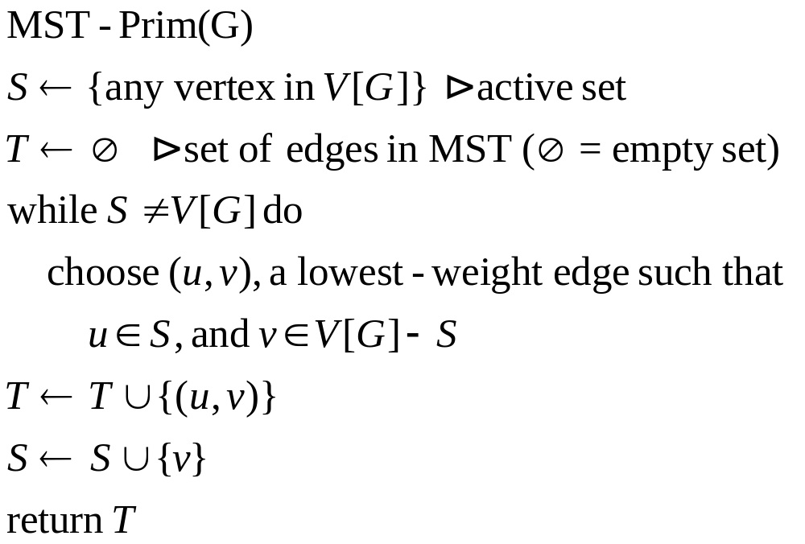
High-level Code for Prim’s

Slide 68
High-Level Prim (Cont.)
How can we choose an edge without looking through every edge in the graph?
Use a priority queue. But make it a queue of vertices, not edges.

Slide 69
A Sophisticated Implementation of Prim’s
1. Build a minimizing priority queue from the graph’s vertices, where the key of a vertex (the value minimized) is the weight of the lowest-weight edge from that vertex to a vertex in the MST.
2. Repeatedly do the following, until the queue is empty:
  a. Extract the minimum vertex from the queue. Call it u.
  b. For each vertex v adjacent to u that is still in the queue, if the weight of the edge between u and v is smaller than key[v], then update key[v] to that weight, and set the parent of v to be u.

Slide 70
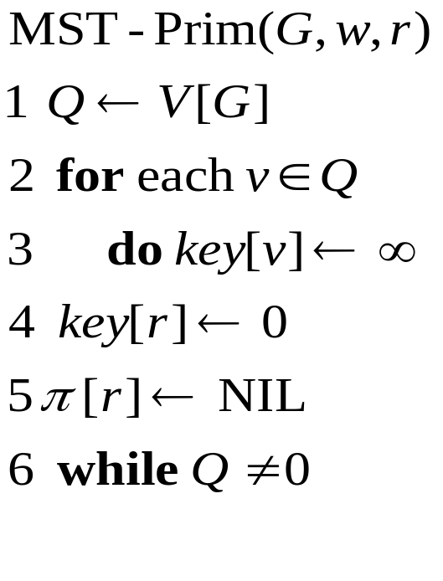
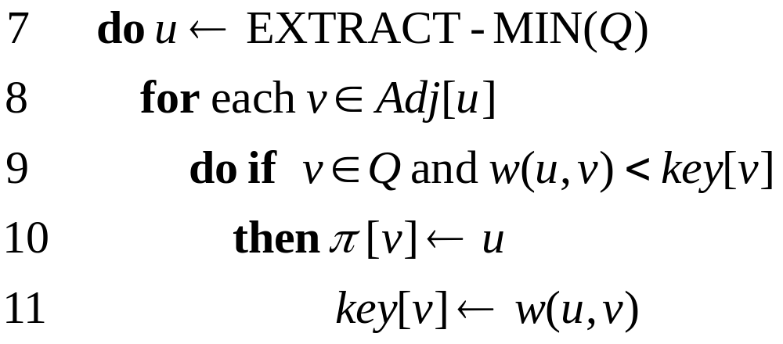
Prim’s à la CLRS
Q contains all the vertices that are not in the MST.
key[v] is the weight of the lowest-weight edge from vertex v to a vertex in the MST.

Slide 71
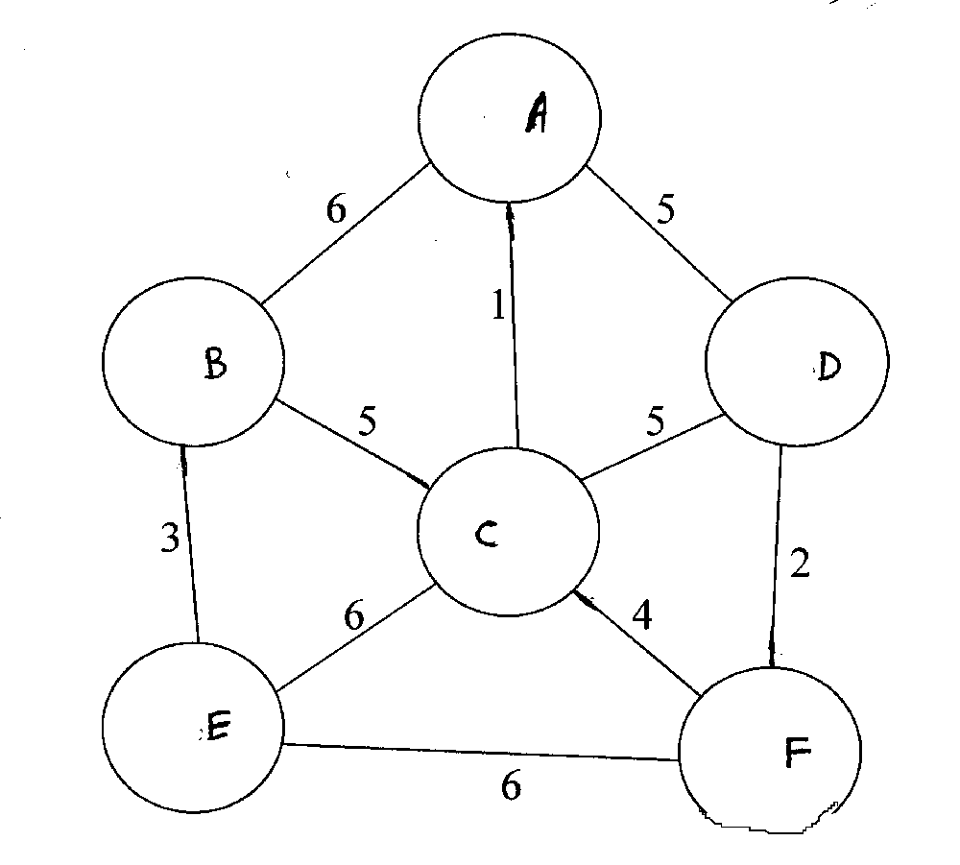

Slide 72
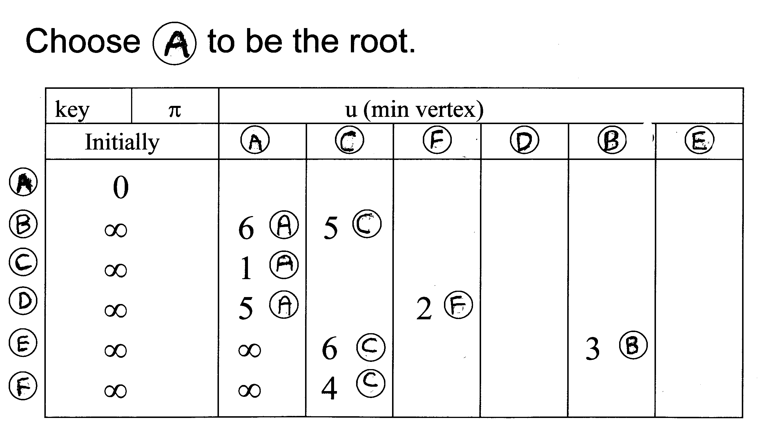
CLRS Prim

Slide 73
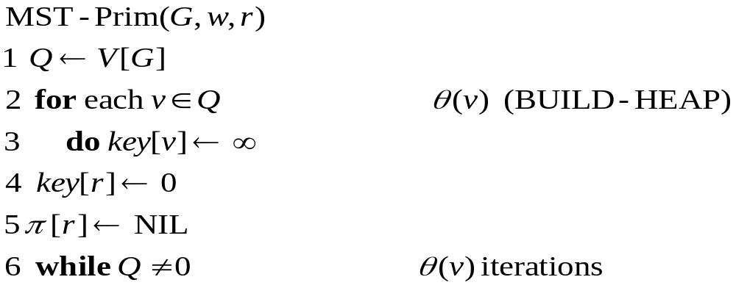
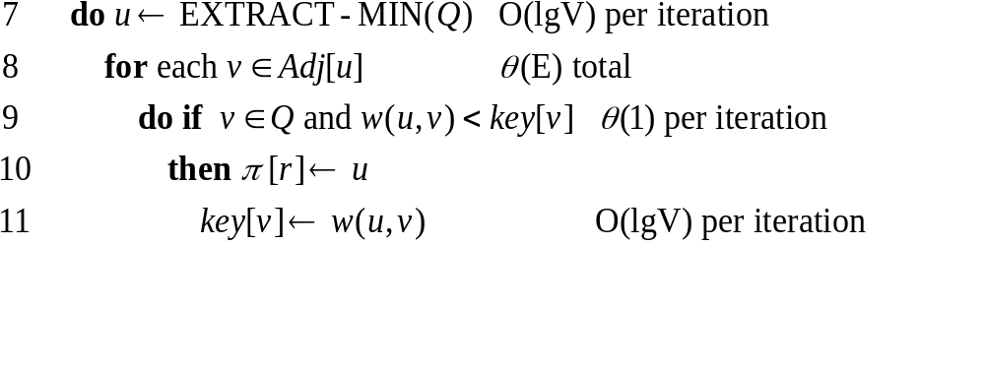
Running Time of Prim

Slide 74
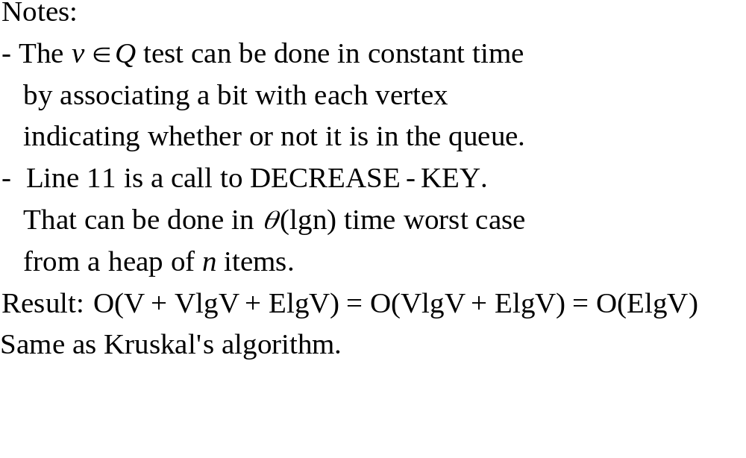
Running Time of Prim (Cont.)

Slide 75
Fibonacci Heaps
It is possible to do better. A Fibonacci Heap is a priority queue implementation that can do
  EXTRACT-MIN in Θ(lgn)
  DECREASE-KEY in Θ(1)
amortized time. (See CLRS, Chapter 20).
Improves the time from Θ(ElgV) to Θ(VlgV+E). (We had Θ(VlgV+ElgV), but the second lgV becomes 1.)
This is better for dense graphs (E ≈ V²).
Theoretical interest only —Fibonacci heaps have a large constant.

Slide 76
The Problems
Given a directed graph G with edge weights, find
  The shortest path from a given vertex s to all other vertices (Single Source Shortest Paths)
  The shortest paths between all pairs of vertices (All Pairs Shortest Paths)
where the length of a path is the sum of its edge weights.

Slide 77
Shortest Paths: Applications
Flying times between cities
Distance between street corners
Cost of doing an activity
  Vertices are states
  Edge weights are costs of moving between states

Slide 78
Shortest Paths: Algorithms
Single-Source Shortest Paths (SSSP)
  Dijkstra’s
  Bellman-Ford
  DAG Shortest Paths
All-Pairs Shortest Paths (APSP)
  Floyd-Warshall
  Johnson’s

Slide 79
A Fact About Shortest Paths
Theorem: If p is a shortest path from u to v, then any subpath of p is also a shortest path.
Proof: Consider a subpath of p from x to y. If there were a shorter path from x to y, then there would be a shorter path from u to v.
shorter?
u
x
y
v

Slide 80
Single-Source Shortest Paths
Given a directed graph with weighted edges, what are the shortest paths from some source vertex s to all other vertices?
Note: shortest path to single destination cannot be done asymptotically faster, as far as we know.
3
6
9
3
2
0
1
4
7
s
3
2
5
5
11
6

Slide 81
Path Recovery
We would like to find the path itself, not just its length.
We’ll construct a shortest-paths tree:
u
v
u
v
3
6
9
3
6
9
s
3
3
2
s
0
2
4
0
4
1
1
2
7
3
2
7
3
5
5
5
11
5
11
x
6
y
x
6
y

Slide 82
Shortest-Paths Idea
δ(u,v) ≡ length of the shortest path from u to v.
All SSSP algorithms maintain a field d[u] for every vertex u. d[u] will be an estimate of δ(s,u). As the algorithm progresses, we will refine d[u] until, at termination,
d[u] = δ(s,u). Whenever we discover a new shortest path to u, we update d[u].
In fact, d[u] will always be an overestimate of δ(s,u):
d[u] ≥ δ(s,u)
We’ll use π[u] to point to the parent (or predecessor) of u on the shortest path from s to u. We update π[u] when we update d[u].

Slide 83
SSSP Subroutine
RELAX(u, v, w)
 (Maybe) improve our estimate of the distance to v
 by considering a path along the edge (u, v).
if d[u] + w(u, v) < d[v] then
d[v] ← d[u] + w(u, v)  actually, DECREASE-KEY
π[v] ← u  remember predecessor on path
d[u]
d[v]
w(u,v)
u
v

Slide 84
Dijkstra’s Algorithm
(pronounced “DIKE-stra”)
Assume that all edge weights are ≥ 0.
Idea: say we have a set K containing all vertices whose shortest paths from s are known
(i.e. d[u] = δ(s,u) for all u in K).
Now look at the “frontier” of K—all vertices adjacent to a vertex in K.
the rest
of the
graph
K
s

Slide 85
Dijkstra’s: Theorem
At each frontier vertex u, update d[u] to be the minimum from all edges from K.
Now pick the frontier vertex u with the smallest value of d[u].
Claim: d[u] = δ(s,u)
min(4+2, 6+1) = 6
4
2
6
1
s
8
6
9
3
min(4+8, 6+3) = 9

Slide 86
Dijkstra’s: Proof
By construction, d[u] is the length of the shortest path to u going through only vertices in K.
Another path to u must leave K and go to v on the frontier.
But the length of this path is at least d[v], (assuming non-negative edge weights),
which is ≥ d[u]. 

Slide 87
Proof Explained
shortest path to u
u
d[u] ≤ d[v]
s
K
another path to u, via v
v
Why is the path through v at least d[v] in length?
We know the shortest paths to every vertex in K.
We’ve set d[v] to the shortest distance from s to v via K.
The additional edges from v to u cannot decrease the path length.

Slide 88
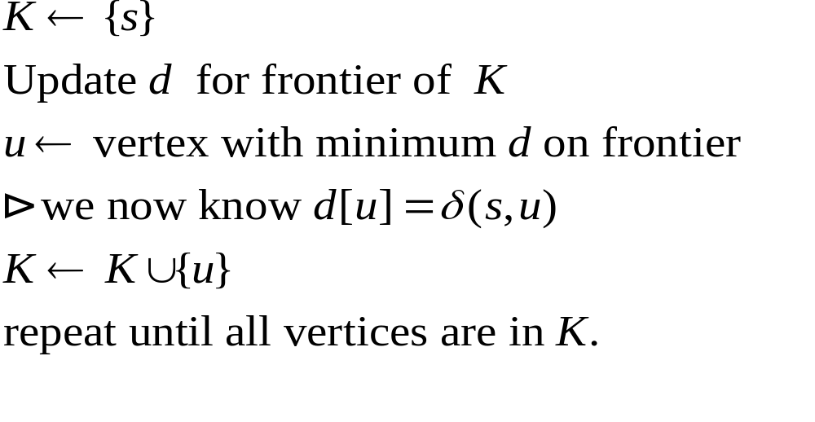
Dijkstra’s Algorithm, Rough Draft
u
u
K
K

Slide 89
A Refinement
Note: we don’t really need to keep track of the frontier.
When we add a new vertex u to K, just update vertices adjacent to u.

Slide 90
Example of Dijkstra’s
8
1
9
10
2
3
9
s
0
7
4
6
5
5
7
2

Slide 91
Code for Dijkstra’s Algorithm
1 DIJKSTRA(G, w, s)  Graph, weights, start vertex
2 for each vertex v in V[G] do
3 d[v] ← ∞
4 π[v] ← NIL
5 d[s] ← 0
6 Q ← BUILD-PRIORITY-QUEUE(V[G])
7  Q is V[G] - K
8 while Q is not empty do
9 u = EXTRACT-MIN(Q)
10 for each vertex v in Adj[u]
11 RELAX(u, v, w) // DECREASE_KEY

Slide 92
Running Time of Dijkstra
Initialization: θ(V)
Building priority queue: θ(V)
“while” loop done |V| times
|V| calls of EXTRACT-MIN
Inner “edge” loop done |E| times
At most |E| calls of DECREASE-KEY
Total time:
Θ(V + V × T_{EXTRACT-MIN} + E × T_{DECREASE-KEY} )

Slide 93
Dijkstra Running Time (cont.)
1. Priority queue is an array.
EXTRACT-MIN in Θ(n) time, DECREASE-KEY in Θ(1)
Total time: Θ(V + VV + E) = Θ(V²)
2. (“Modified Dijkstra”)
Priority queue is a binary (standard) heap.
EXTRACT-MIN in Θ(lgn) time, also DECREASE-KEY
Total time: Θ(VlgV + ElgV)
3. Priority queue is Fibonacci heap. (Of theoretical interest only.)
EXTRACT-MIN in Θ(lgn),
DECREASE-KEY in Θ(1) (amortized)
Total time: Θ(VlgV+E)

Slide 94
The Bellman-Ford Algorithm
Handles negative edge weights
Detects negative cycles
Is slower than Dijkstra
4
-10
5
a negative cycle

Slide 95
Bellman-Ford: Idea
Repeatedly update d for all pairs of vertices connected by an edge.
Theorem: If u and v are two vertices with an edge from u to v, and s ⇒ u → v is a shortest path, and d[u] = δ(s,u),
then d[u]+w(u,v) is the length of a shortest path to v.
Proof: Since s ⇒u → v is a shortest path, its length is δ(s,u) + w(u,v) = d[u] + w(u,v). 

Slide 96
Why Bellman-Ford Works
On the first pass, we find δ (s,u) for all vertices whose shortest paths have one edge.
On the second pass, the d[u] values computed for the one-edge-away vertices are correct (= δ (s,u)), so they are used to compute the correct d values for vertices whose shortest paths have two edges.
Since no shortest path can have more than |V[G]|-1 edges, after that many passes all d values are correct.
Note: all vertices not reachable from s will have their original values of infinity. (Same, by the way, for Dijkstra).

Slide 97
Bellman-Ford: Algorithm
BELLMAN-FORD(G, w, s)
1 foreach vertex v ∈V[G] do //INIT_SINGLE_SOURCE
2 d[v] ← ∞
3 π[v] ← NIL
4 d[s] ← 0
5 for i ← 1 to |V[G]|-1 do  each iteration is a “pass”
6 for each edge (u,v) in E[G] do
7 RELAX(u, v, w)
8  check for negative cycles
9 for each edge (u,v) in E[G] do
10 if d[v] > d[u] + w(u,v) then
11 return FALSE
12 return TRUE
Running time: Θ(VE)

Slide 98
Negative Cycle Detection
What if there is a negative-weight
cycle reachable from s?
Assume: d[u] ≤ d[x]+4
d[v] ≤ d[u]+5
d[x] ≤ d[v]-10
Adding:
d[u]+d[v]+d[x] ≤ d[x]+d[u]+d[v]-1
Because it’s a cycle, vertices on left are same as those on right. Thus we get 0 ≤ -1; a contradiction.
So for at least one edge (u,v),
d[v] > d[u] + w(u,v)
This is exactly what Bellman-Ford checks for.
x
4
u
-10
5
v

Slide 99
SSSP in a DAG
Recall: a dag is a directed acyclic graph.
If we update the edges in topologically sorted order, we correctly compute the shortest paths.
Reason: the only paths to a vertex come from vertices before it in the topological sort.
9
s
0
1
4
6
1
3
2

Slide 100
SSSP in a DAG Theorem
Theorem: For any vertex u in a dag, if all the vertices before u in a topological sort of the dag have been updated, then d[u] = δ(s,u).
Proof: By induction on the position of a vertex in the topological sort.
Base case: d[s] is initialized to 0.
Inductive case: Assume all vertices before u have been updated, and for all such vertices v, d[v]=δ(s,v). (continued)

Slide 101
Proof, Continued
Some edge (v,u) where v is before u, must be on the shortest path to u, since there are no other paths to u.
When v was updated, we set d[u] to d[v]+w(v,u)
= δ(s,v) + w(v,u)
= δ(s,u) 

Slide 102
SSSP-DAG Algorithm
DAG-SHORTEST-PATHS(G,w,s)
1 topologically sort the vertices of G
2 initialize d and π as in previous algorithms
3 for each vertex u in topological sort order do
4 for each vertex v in Adj[u] do
5 RELAX(u, v, w)
Running time: θ(V+E), same as topological sort

Slide 103
All-Pairs Shortest Paths
We now want to compute a table giving the length of the shortest path between any two vertices. (We also would like to get the shortest paths themselves.)
We could just call Dijkstra or Bellman-Ford |V| times, passing a different source vertex each time.
It can be done in Θ(V³), which seems to be as good as you can do on dense graphs.

Slide 104
Doing APSP with SSSP
Dijkstra would take time
Θ(V × V²) = Θ(V³) (standard version)
Θ(V × (VlgV + E)) = Θ(V²lgV + VE)) (modified, Fibonacci heaps),
but doesn’t work with negative-weight edges.
Bellman-Ford would take Θ(V × VE) = Θ(V²E).

Slide 105
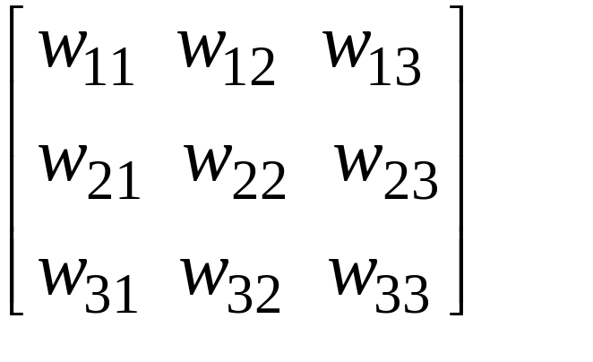
The Floyd-Warshall Algorithm
Represent the directed, edge-weighted graph in adjacency-matrix form.
W= matrix of weights =
w_{ij} is the weight of edge (i, j), or ∞ if there is no such edge.
Return a matrix D, where each entry d_{ij} is δ(i,j).
Could also return a predecessor matrix, P, where each entry π_{ij} is the predecessor of j on the shortest path from i.

Slide 106
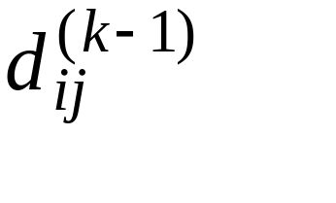
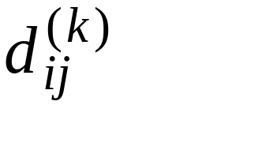
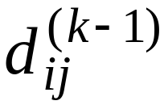
Floyd-Warshall: Idea
Consider intermediate vertices of a path:
i
j
Say we know the length of the shortest path from i to j whose intermediate vertices are only those with numbers 1, 2, ..., k-1. Call this length
Now how can we extend this from k-1 to k? In other words, we want to compute . Can we use , and if so how?

Slide 107
Floyd-Warshall Idea, 2
k
i
j
Two possibilities:
1. Going through the vertex k doesn’t help— the path through vertices 1...k-1 is still the shortest.
2. There is a shorter path consisting of two subpaths, one from i to k and one from k to j. Each subpath passes only through vertices numbered 1 to k-1.

Slide 108
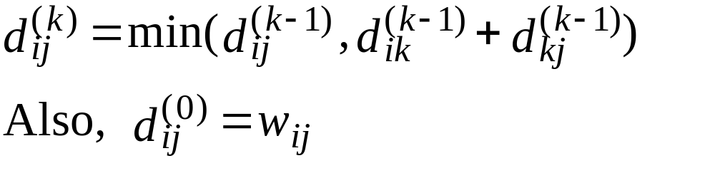
Floyd-Warshall Idea,3
Thus,
(since there are no intermediate vertices.)
When k = |V|, we’re done.

Slide 109
Dynamic Programming
Floyd-Warshall is a dynamic programming algorithm:
Compute and store solutions to sub- problems. Combine those solutions to solve larger sub-problems.
Here, the sub-problems involve finding the shortest paths through a subset of the vertices.

Slide 110
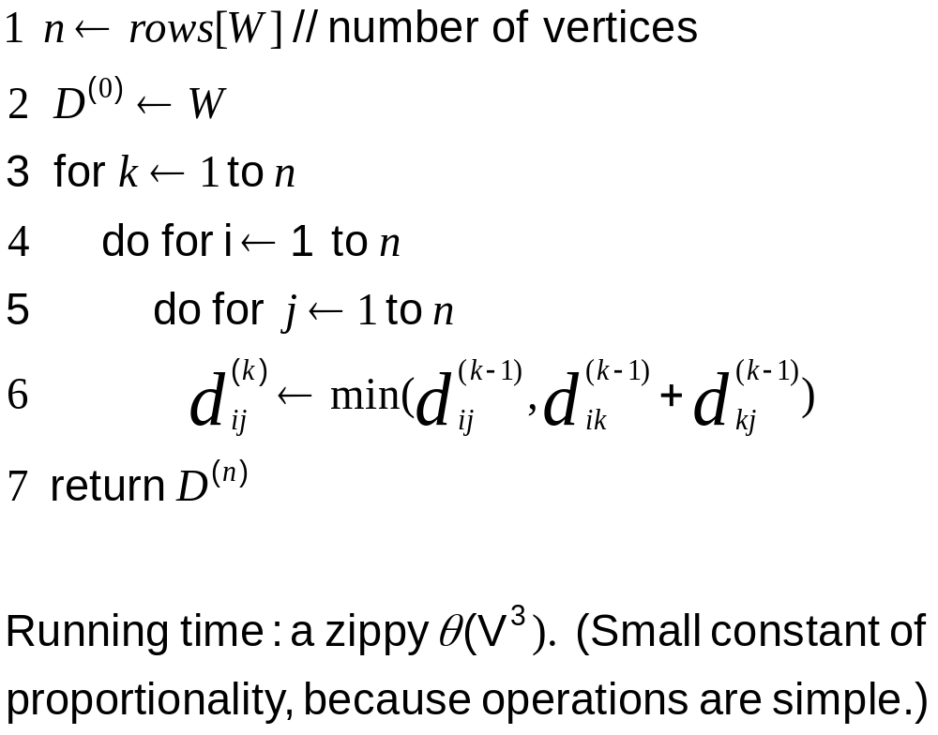
Code for Floyd-Warshall
Floyd-Warshall(W)

Slide 111
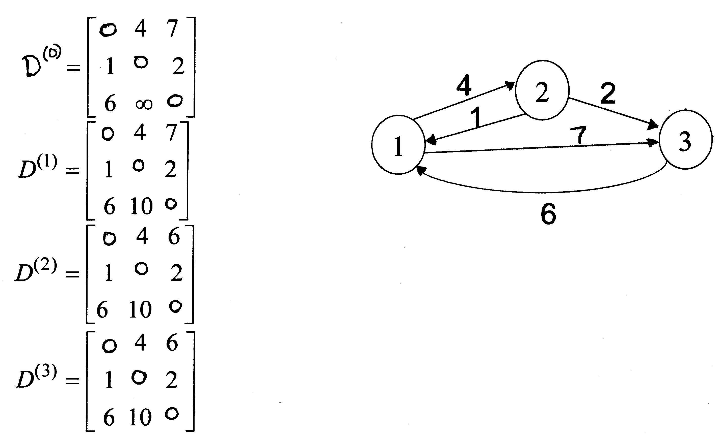
Example of Floyd-Warshall

Slide 112
Johnson’s Algorithm
Makes clever use of Bellman-Ford and Dijkstra to do All-Pairs-Shortest-Paths efficiently on sparse graphs.
Motivation: By running Dijkstra |V| times, we could do APSP in time Θ(V²lgV +VElgV) (Modified Dijkstra), or Θ(V²lgV +VE) (Fibonacci Dijkstra). This beats Θ(V³) (Floyd-Warshall) when the graph is sparse.
Problem: negative edge weights.

Slide 113
The Basic Idea
Reweight the edges so that:
  No edge weight is negative.
  Shortest paths are preserved. (A shortest path in the original graph is still one in the new, reweighted graph.)
An obvious attempt: subtract the minimum weight from all the edge weights. E.g. if the minimum weight is -2:
-2 - -2 = 0
3 - -2 = 5
etc.

Slide 114
Counterexample
Subtracting the minimum weight from every weight doesn’t work.
Consider:
Paths with more edges are unfairly penalized.
-2
0
-2
-1
0
1

Slide 115
Johnson’s Insight
Add a vertex s to the original graph G, with edges of weight 0 to each vertex in G:
Assign new weights ŵ to each edge as follows:
ŵ(u, v) = w(u, v) + δ(s, u) - δ(s, v)
0
0
s
0

Slide 116
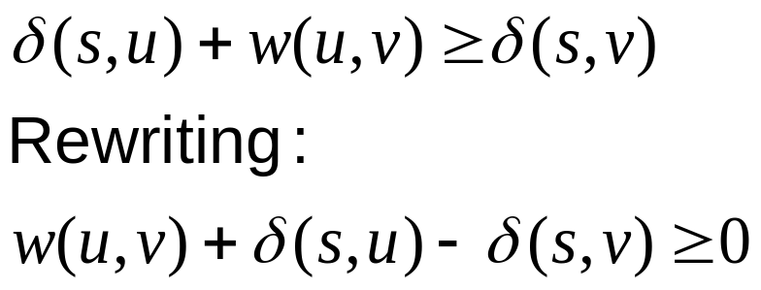

Question 1
Are all the ŵ’s non-negative? Yes:
Otherwise, s ⇒ u → v would be
shorter than the shortest path
from s to v.
δ(s, u)
u
s
w(u, v)
δ(s, v)
v

Slide 117

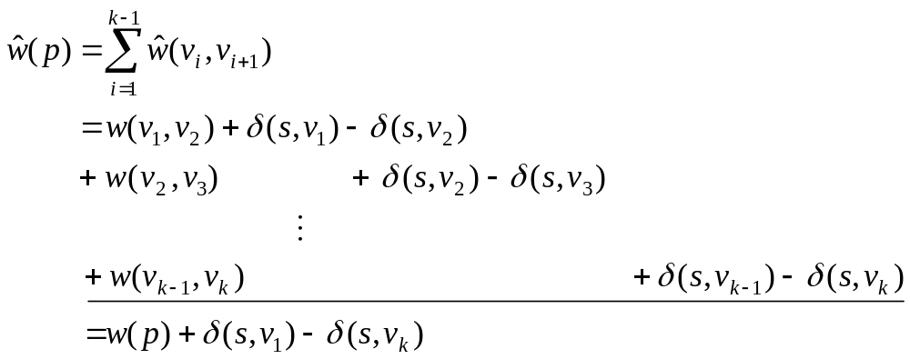
Question 2
Does the reweighting preserve shortest paths? Yes: Consider any path
the sum
telescopes
A value that depends only on the endpoints, not on the path.
In other words, we have adjusted the lengths of all paths by the same amount. So this will not affect the relative ordering of the paths—
shortest paths will be preserved.

Slide 118
Question 3
How do we compute the δ(s, v)’s?
Use Bellman-Ford.
This also tells us if we have a negative-weight cycle.

Slide 119

Johnson’s: Algorithm
Compute G’, which consists of G augmented with s and a zero-weight edge from s to every vertex in G.
Run Bellman-Ford(G’, w, s) to obtain the δ(s,v)’s
Reweight by computing ŵ for each edge
Run Dijkstra on each vertex to compute
Undo reweighting factors to compute δ

Slide 120
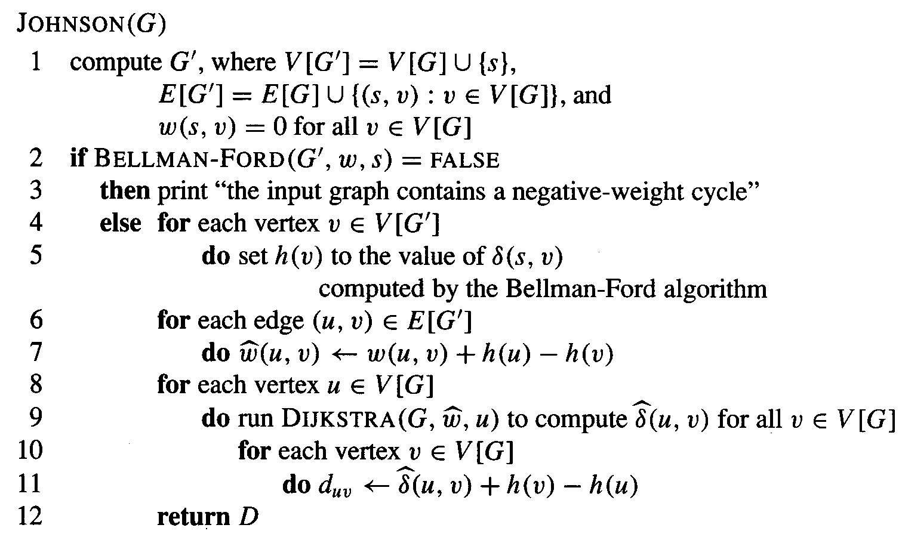
Johnson’s: CLRS

Slide 121
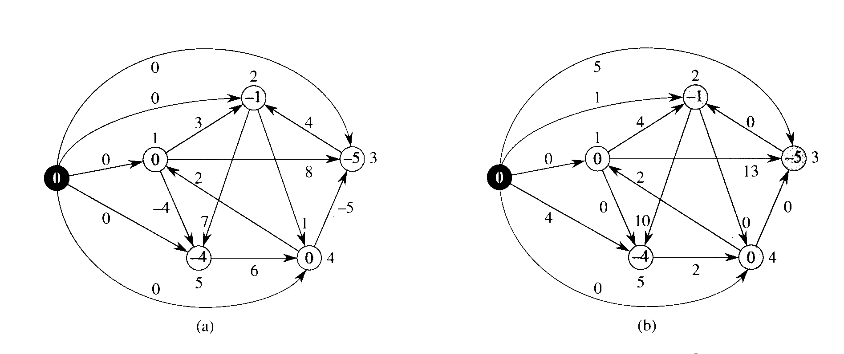
Johnson: reweighting
ŵ(u, v) = w(u, v) + d(s, u) - d(s, v)

Slide 122
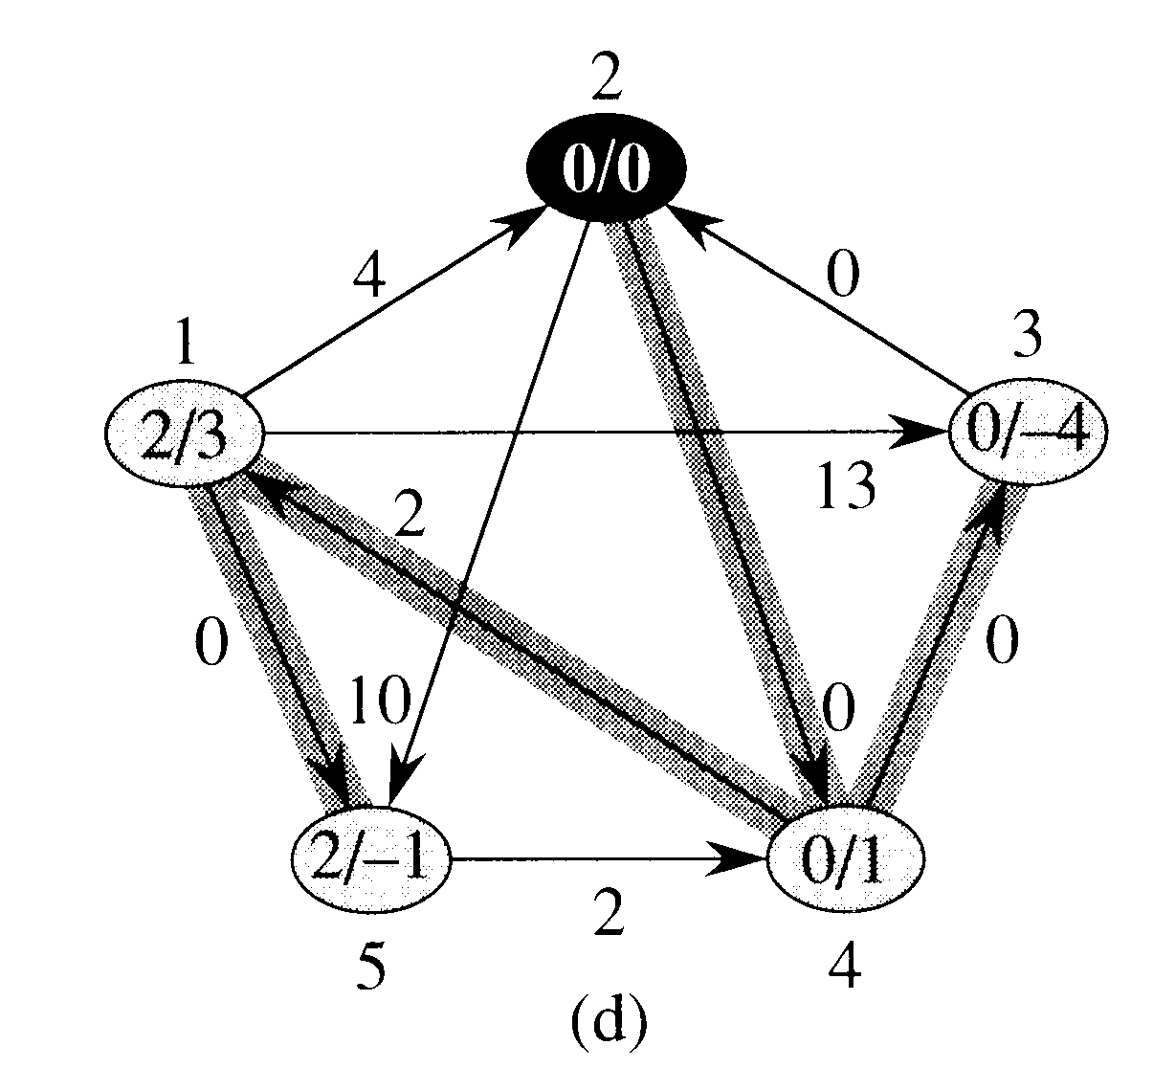
Johnson using Dijkstra

Slide 123
Johnson’s: Running Time
Computing G’: Θ(V)
Bellman-Ford: Θ(VE)
Reweighting: Θ(E)
Running (Modified) Dijkstra: Θ(V²lgV +VElgV)
Adjusting distances: Θ(V²)
—————————————————————
Total is dominated by Dijkstra: Θ(V²lgV +VElgV)

